Slide 1



Evaluation of meat quality attributes of US Highland cattle
Peckman, T. E., Z. D. Callahan, T. A. Wilmoth, and B. R. Wiegand
Division of Animal Sciences, University of Missouri, Columbia, Missouri

Slide 2
Materials and Methods
2 steaks and 1 ground beef sample were received from producers
Cook Loss= 1 steak sample
  All steaks were thawed for 48 h at approximately 2ºC prior to cooking.
  Prior to cooking, a raw weight was obtained for each steak.
  Steaks were cooked on a convection oven to achieve a final internal temperature of 71ºC.
  After cooking, a cooked weight was obtained.
  Cook yield was determined as a percentage using the following formula (cooked weight/raw weight) x 100.

Slide 3
Materials and Methods
Six cores were collected from the cook steak and were used to measure tenderness using Warner-Bratzler Shear Force.
Fatty Acid Analysis= 1 steak/ground beef sample
  The methodology utilized for fatty acid determination was an adaptation of the methods used by Folch et al. (1957) and Morrison and Smith (1964).
  Calculated Iodine value

Slide 4
Key to Identifiers
S = Steer, H = Heifer
E = East, C = Central, M = Mountain, P = Pacific
1 = grass, 2 = stored forage, 3 = grain, 4 = grass/stored forage, 5 = grass/grain, 6 = grass/stored forage/grain
Data presented is from 183 hd of cattle

Slide 5
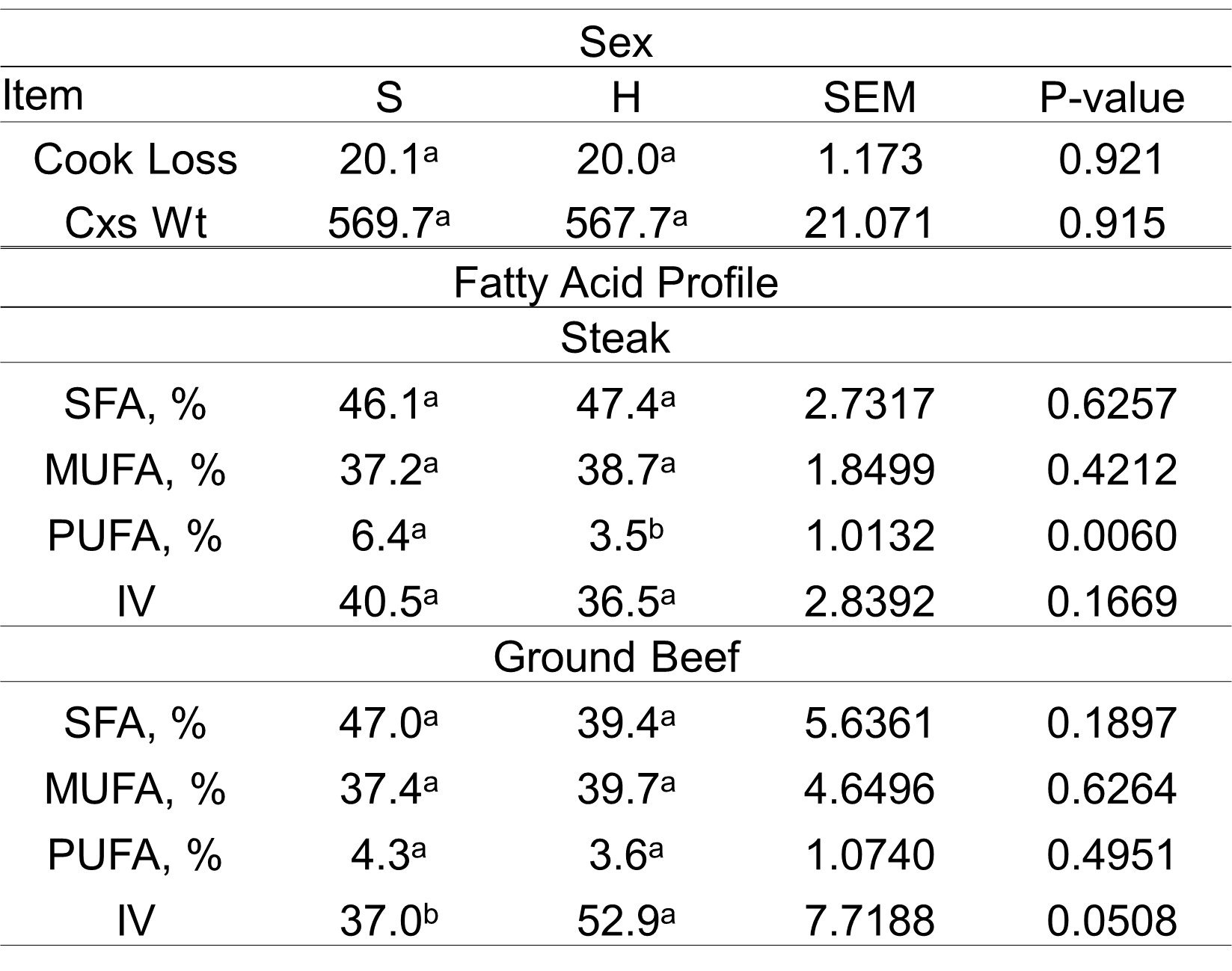
Table 1. Effect of sex on cook loss, carcass weight, and fatty acid composition.
^{a-d}Means within the same row for treatment or muscle that have different superscripts are significantly different (P ˂ 0.05)

Slide 6
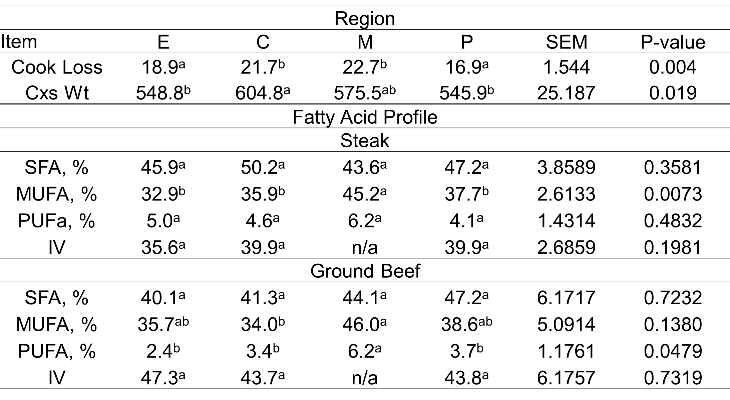
Table 2. Effect of region on cook loss, carcass weight, and fatty acid composition.
^{a-d}Means within the same row for treatment or muscle that have different superscripts are significantly different (P ˂ 0.05)

Slide 7
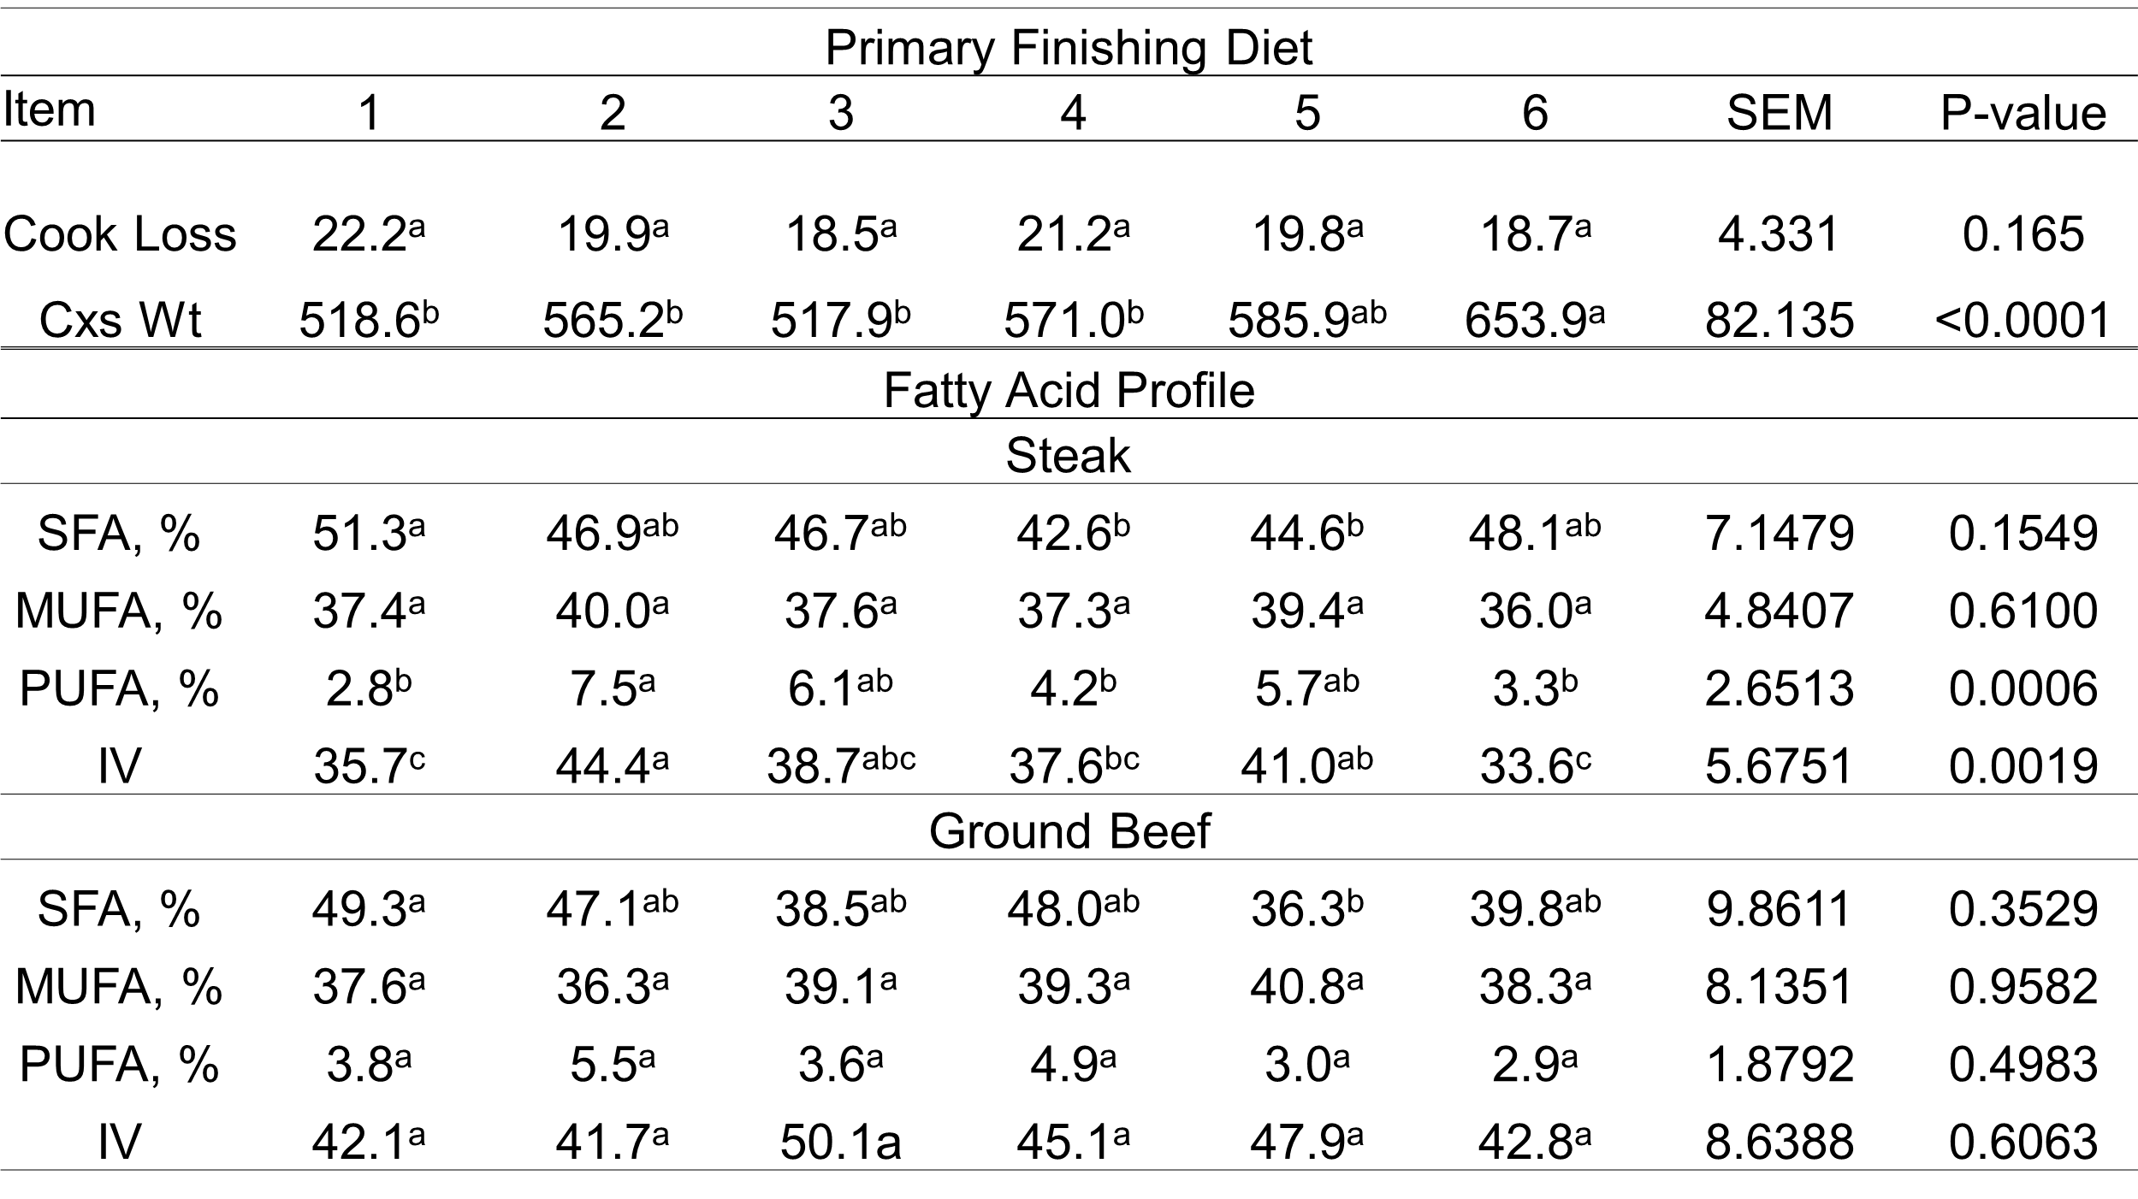
Table 3. Effect of primary finishing diet on cook loss, carcass weight, and fatty acid profile.
^{a-d}Means within the same row for treatment or muscle that have different superscripts are significantly different (P ˂ 0.05)

Slide 8
Table.4 Warner-Bratzler Shear Force values for each category.
Primary Finishing Diet
1 | 2 | 3 | 4 | 5 | 6 | SEM | P-value
3.55 | 3.66 | 2.47 | 3.44 | 3.62 | 3.52 | 1.05 | 0.9074
Region
E | C | M | P
3.19 | 3.68 | 3.21 | 3.43 |  |  | 0.34 | 0.2058
Sex
S | H
3.37 | 3.38 |  |  |  |  | 0.27 | 0.9559

Slide 9
Triangle Sensory Test
Trained Panelists
Same 8 panelists for each session
Two samples same, one different
Can panelist identify the different sample?
Not a preference test

Slide 10
Triangle Test (Grass vs. Grain)

Slide 11
Triangle Test (Highland vs. Commodity)

Slide 12
Marketing Recommendations
Target selling cattle under 30 months of age
Target minimum of 550 lb. carcass
Sell on tenderness
Sell on fatty acid profile if grass/forage finishing

Slide 13
Future Research Ideas
Centralized performance bull test
Progeny steer test
Contemporary steer feedout

